Slide 1


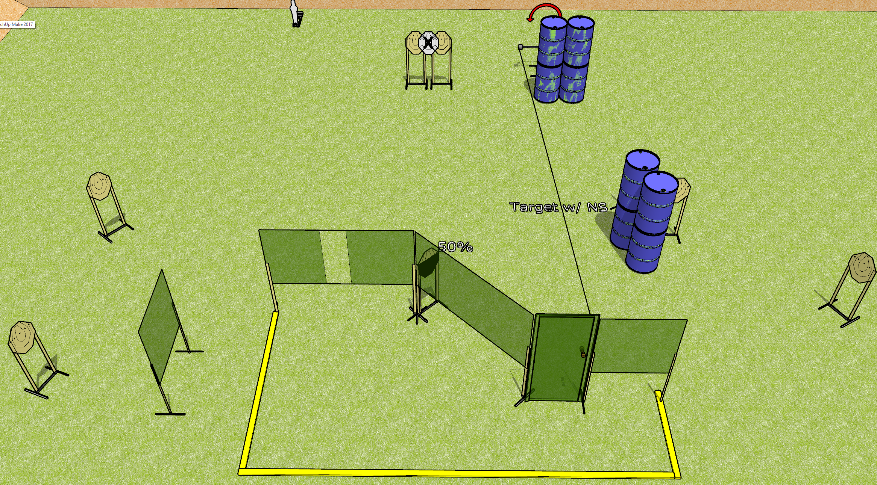
 | Dothan Gun Club – USPSA Match Open and Drop Course Designer : Drew Coleman
Round Count 19 rounds 9 IPSC 1 mini popper
Equipment List 1 medium fault line (use 10’ for far left) 1 50% Swinger + activator + door

Slide 2
Open and Drop
Written Stage Briefing
Open and Drop is a 19 round, 95 point, Comstock course of fire. There are 9 IPSC targets and 1 mini popper. The best 2 hits on paper will score, and steel must fall to score. The start signal is audible.
The swinger is activated by the door and is visible at rest.
Handgun start position is anywhere, wrists below belt. Handgun loaded and holstered.
PCC start position is anywhere, stock on belt. Loaded carbine is held with both hands, safety on.
On start signal, engage targets as they become available from within the shooting area.

